Slide 1
Bird Strikes between 2000 – 2011

Slide 2
Introduction
Transport analytics highlights concerns on environmental impacts and safety, with bird strikes posing a significant threat to aircraft safety. Leveraging MAS technology becomes essential for effective mitigation.

Slide 3
Objective
Bird strikes, collisions between birds and aircraft, are a serious safety concern. They can cause significant damage to aircraft, particularly jet-engine ones, and have led to fatal accidents. Occurring most likely during take-off, climb, approach, and landing, these incidents pose a persistent threat to aviation safety.
Problem Statement​
The goal of this project is to analyse the bird strike incidents happened between 2000-2011. To achieve the goal, we used a data set that is collected by FAA during 2000-2011. The objective of the project is to perform data visualization techniques to understand insights of the data. This project aims apply various Business Intelligence tools such as Tableau or Power BI to get a visual understanding of the data. ​

Slide 4
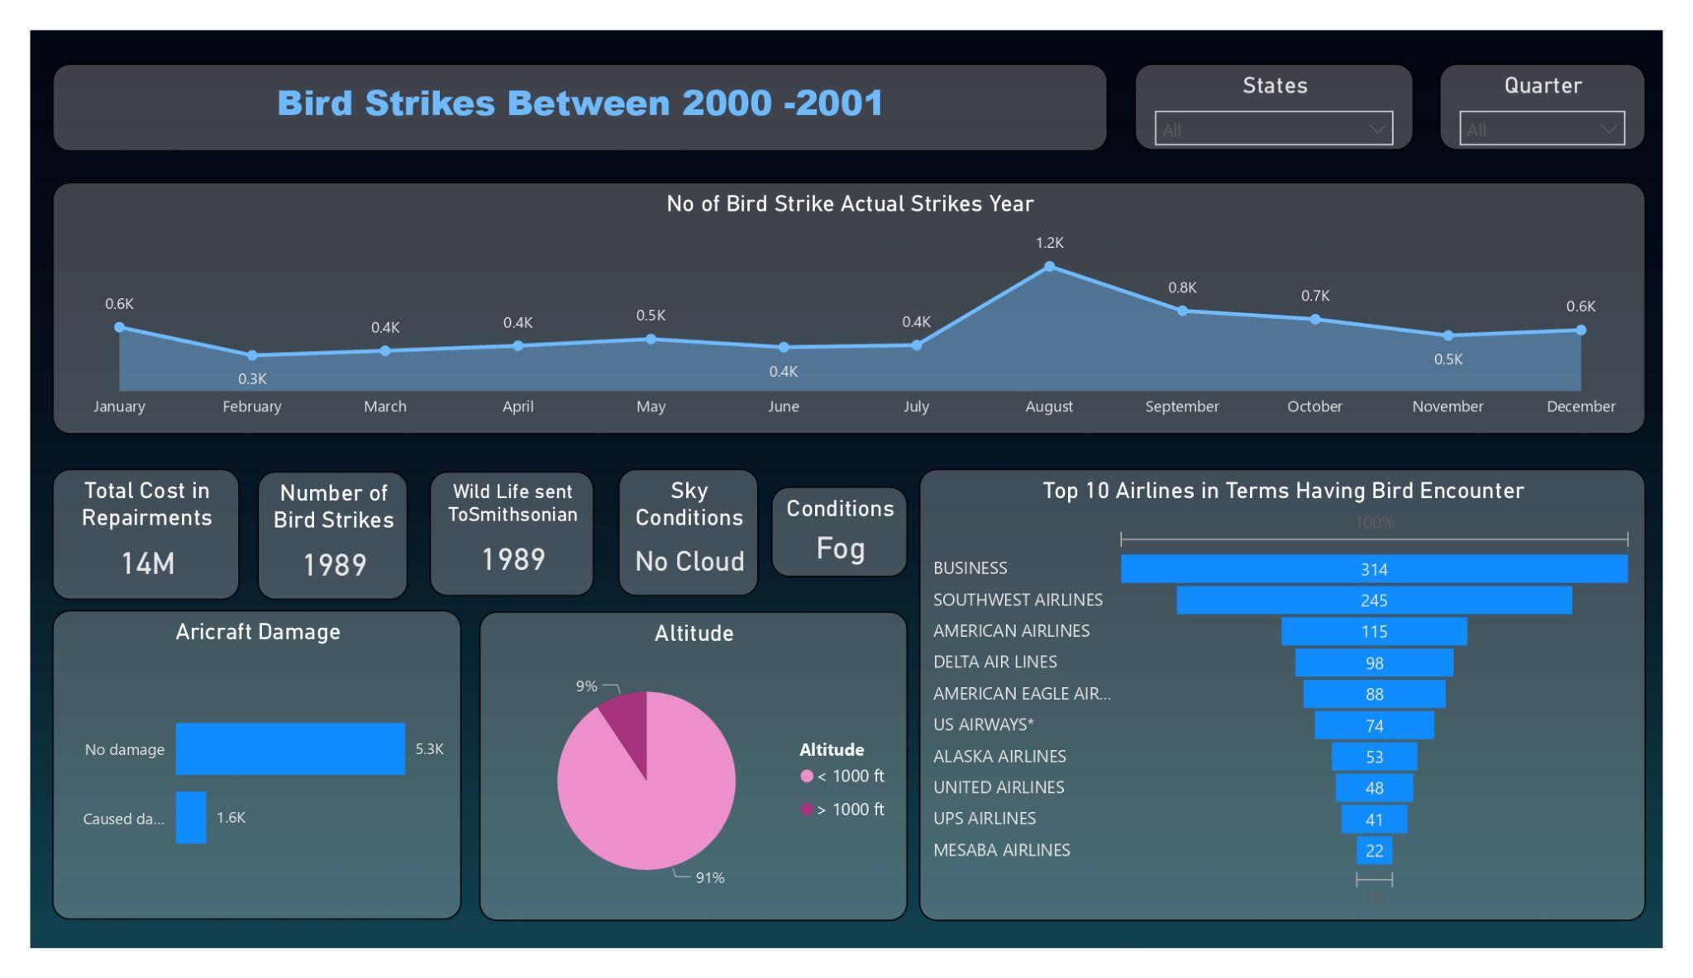
Insights​

Slide 5
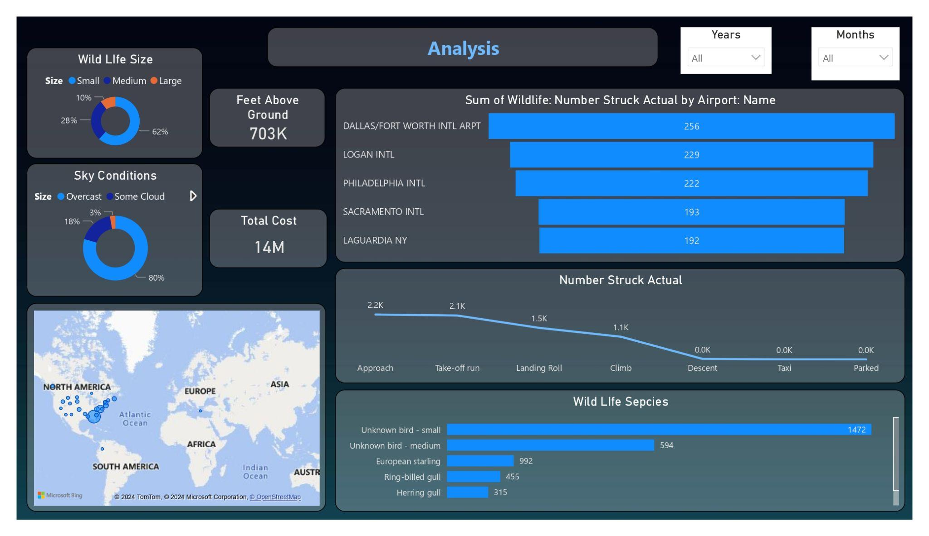
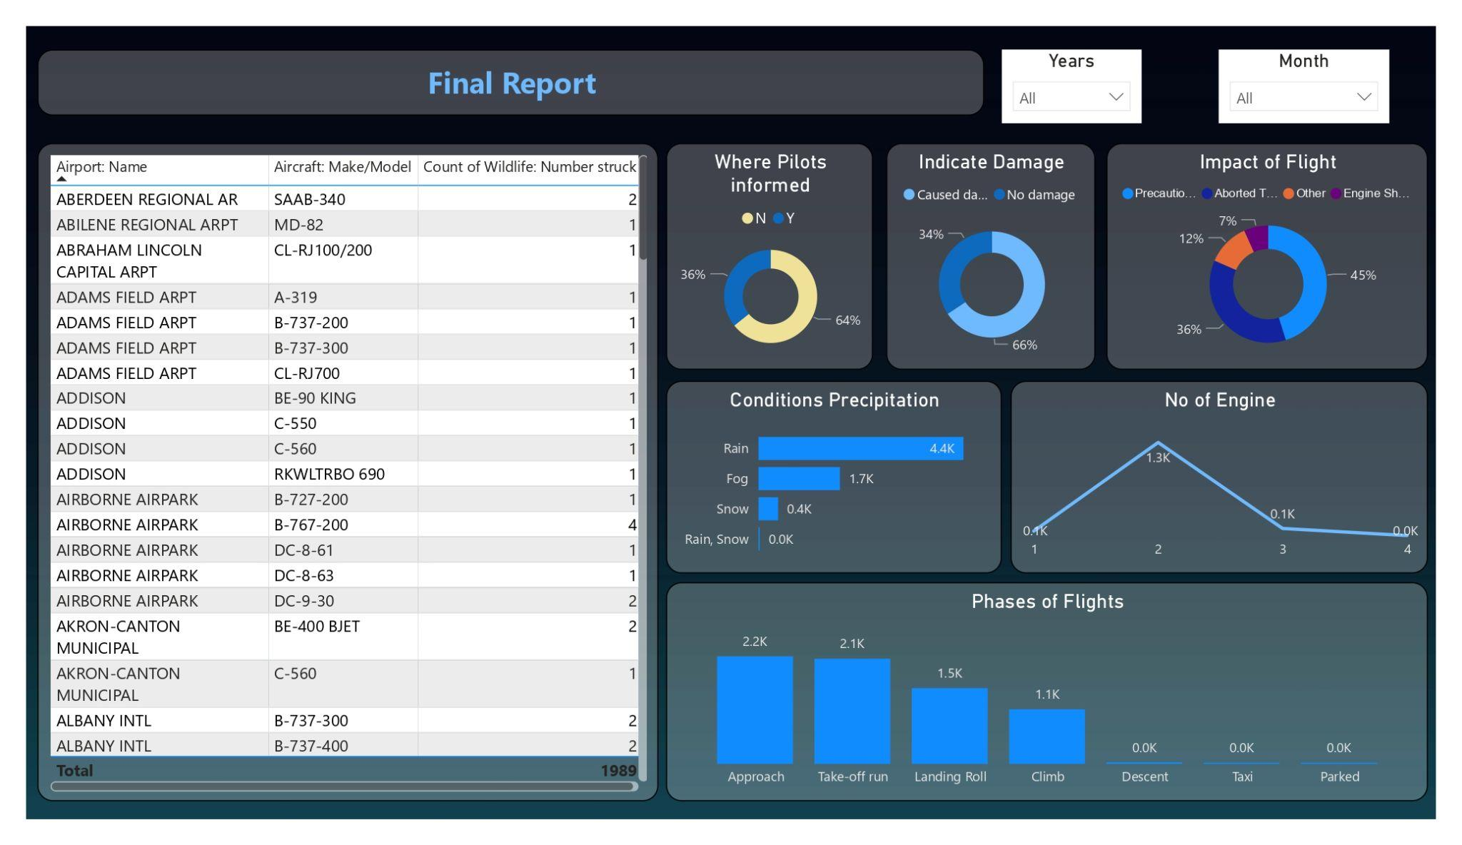
My Design

Slide 6
Conclusion
42.72% incidents where pilot was warned about the birds​
​
Prior warning to the pilot reduces the risk of damage to the aircraft​
​
52.78% of incidents have happened due to some small unknown bird.​
​
72.9% incidents have happened when there is 1 bird/wildlife is struck in the airplane and caused damage.​
​90.31% incidents caused no damage while 9.69% incidents caused damage​
80.84% of bird strike incidents have happened when the altitude of airplane was <1000 ft and 19.16% have happened when altitude was >1000 ft.​
Most of the incidents have happened when there is no cloud in each year​

Slide 7
Thank you

